Slide 1
Network Parameter Influence on Communications in Dense Wireless Nanonetworks
Carole Al Mawla
Eugen Dedu
Université de Franche-Comté, CNRS, institut FEMTO-ST, France
ACM NanoCom 2024
Milan, Italy, October 28–30, 2024
Lebanese University
Faculty of science

Slide 2
Plan
01
Wireless nanonetwork
Routing protocol
Network parameters influence
Conclusion & Future work
02
03
05
1 / 16

Slide 3
01
Wireless nanonetwork
2 / 16
Carole Al Mawla

Slide 4
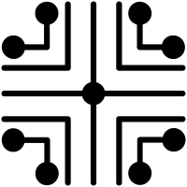
Wireless nanonetwork
01
Hundreds or thousands of tiny nodes called nanonodes
Nanonode size is less than 1 micrometer (1 to 1000 nanometers)
Nanonode limitations:
Simple computing, sensing, and actuation
Low resources (CPU, memory, battery) due to fabrication constraints
Low network lifetime because of energy/battery limitation
Routing protocol
3 / 16
Carole Al Mawla
Notes:
A wireless nanonetwork is composed of hundreds or thousands of tiny nodes called nanonode
These nanonodes are of size less than 1 micrometer and has lots of limitations like ….
Note that a good wireless nanonetwork is reflect by its routing protocol

Slide 5
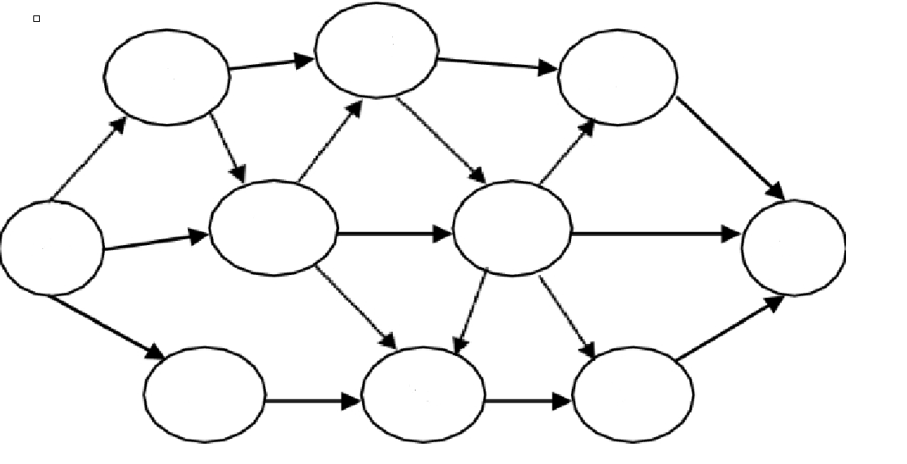
02
Routing protocol
4 / 16
Carole Al Mawla

Slide 6
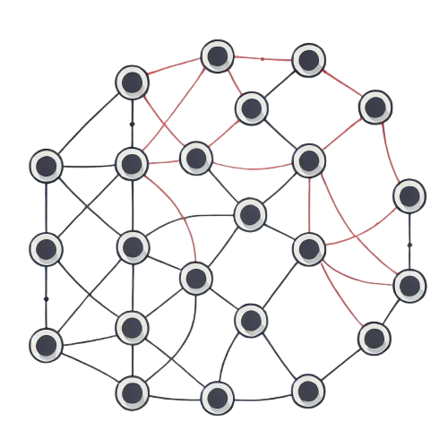
Routing protocol
02
A good routing protocol in a multi-hop network:
Selects the best path through the network from the source to the destination
This is not enough
Good protocol also needs optimal network parameters
D
S
5 / 16
Notes:
The well knowing concept of a good routing protocol is influenced by how the protocol select the most optimal path through the network from the source to the destination
Here we are showing that not a good routing protocol might give different consequences on network if the parameter choosed are bad

Slide 7
03
Network parameters influence
6 / 16
Carole Al Mawla

Slide 8
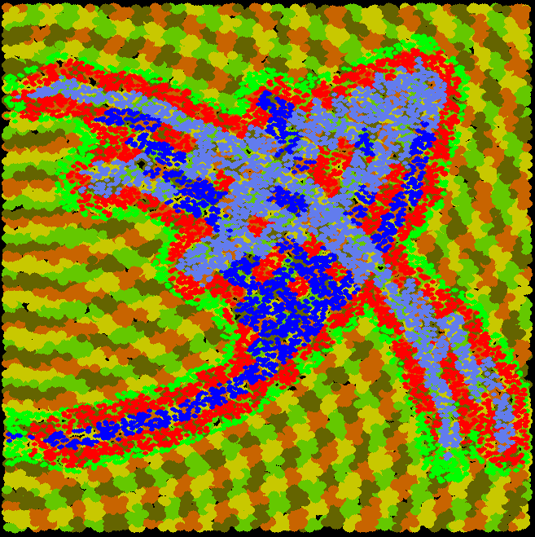
Evaluated network scenario
03
10,000 nodes
BitSimulator + VisualTracer designed for dense networks
Two node placements: homogeneous and heterogeneous
9 flows, creating a congested zone in the middle
1 and 20 packets per flow
Results are reproducible and available on http://eugen.dedu.free.fr/bitsimulator/nanocom24
8 / 16

Slide 9
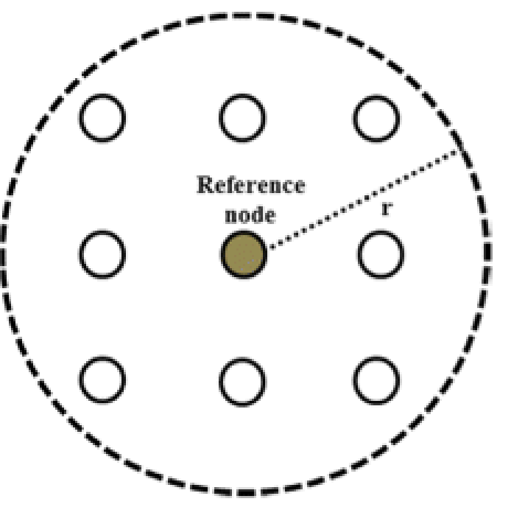
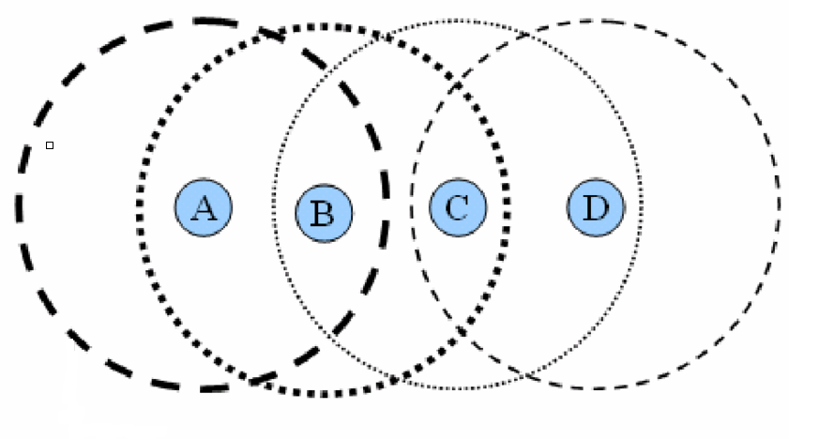
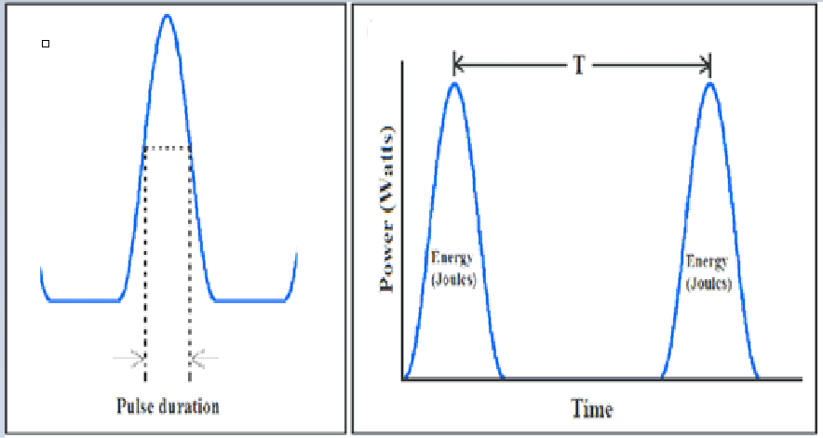
Investigated parameters
03
Symbol rate (beta, 𝛽)
The ratio of time between two consecutive pulses sent and the pulse length Ts / Tp
Communication range
The effective distance over which communication occurs
Node density
Number of neighboring nodes per communication range
Pulse duration
7 / 16

Slide 10
Evaluated metrics
03
Number of packet collisions
Number of packet receptions
Number of packet emissions
Number of packet deliveries to destination
8 / 16

Slide 11
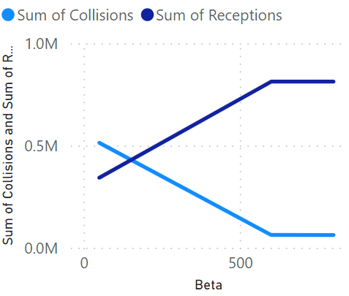
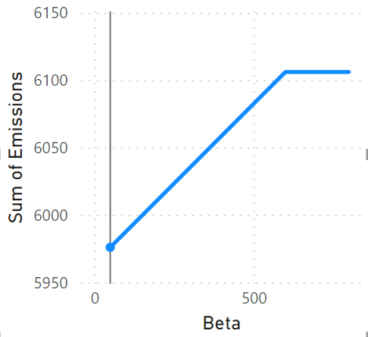
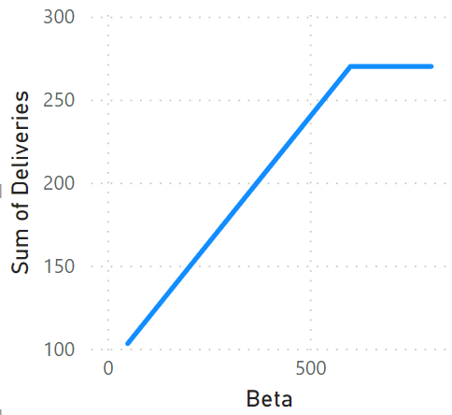
Influence of 𝛽
03
Increasing 𝛽:
Reduces the number of packet collisions
Increases the number of packet receptions and transmissions and deliveries
Beta | Collisions | Receptions | Emissions | Deliveries
50 | 513,624 | 342,677 | 5,976 | 103
600 | 62,614 | 812,850 | 6,106 | 270
800 | 62,559 | 812,905 | 6,106 | 270
9 / 16

Slide 12
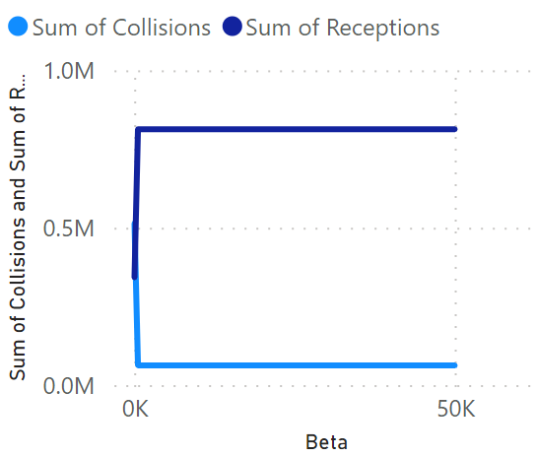
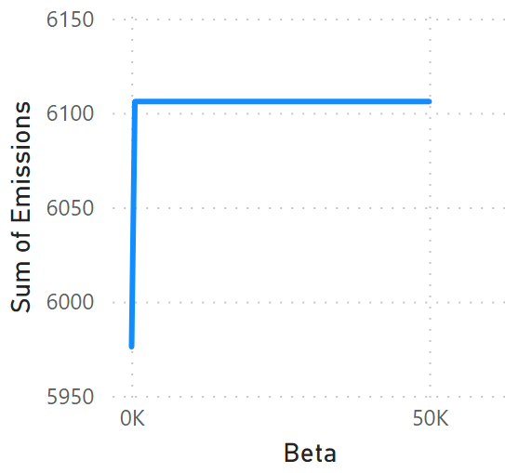
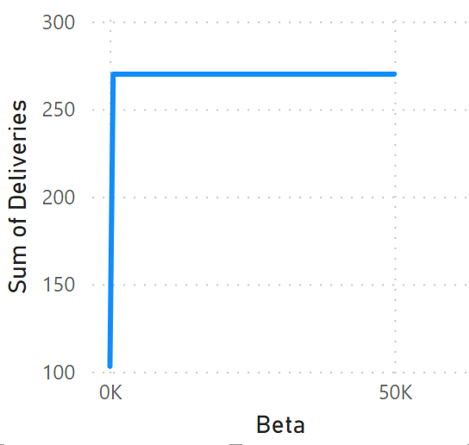
Influence of 𝛽
03
After a certain point (called optimal 𝛽), further maximizing 𝛽 has no effect on the network metrics
Beta | Collisions | Receptions | Emissions | Deliveries
50 | 513,624 | 342,677 | 5,976 | 103
600 | 62,614 | 812,850 | 6,106 | 270
800 | 62,559 | 812,905 | 6,106 | 270
1000 | 62,559 | 812,905 | 6,106 | 270
50,000 | 62,559 | 812,905 | 6,106 | 270
10 / 16

Slide 13
Influence of 𝛽
03
The optimal value of 𝛽 increases with network density, and depends on the protocol, the number of packets per flow, etc.
 | Optimal beta
Number of nodes | 1 packet per flow | 20 packet per flow
10,000 | 600 | 600
20,000 | 800 | 800
30,000 | 800 | 800
40,000 | 800 | 1000
11 / 16

Slide 14
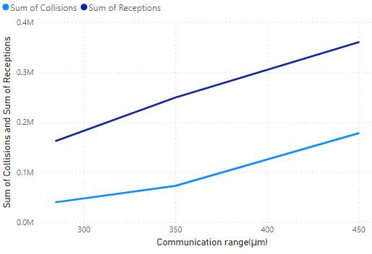
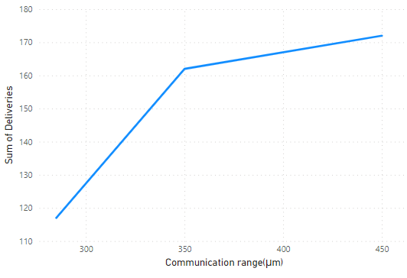
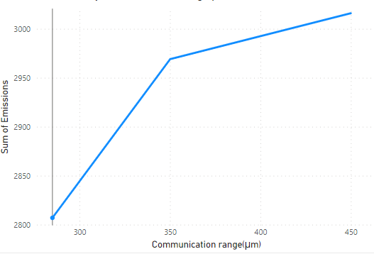
Influence of communication range
03
Increasing communication range:
Increases the number of packet collision, transmission, reception, and deliveries
Communication range (μm) | Collisions | Receptions | Emissions | Deliveries
285 | 39,960 | 162,733 | 2,807 | 117
350 | 72,730 | 249,519 | 2,969 | 162
450 | 178,075 | 360,315 | 3,016 | 172
12 / 16
Notes:
A larger communication range implies more neighboring nodes to fall within reach, consequently, more packets are received, which in turn results in increased retransmissions (emissions) within the relay nodes.

Slide 15
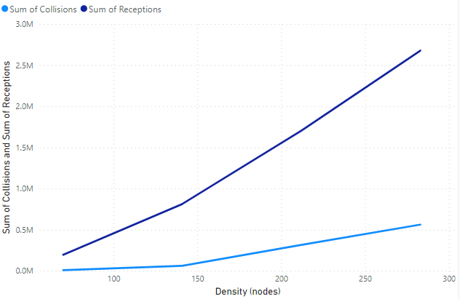
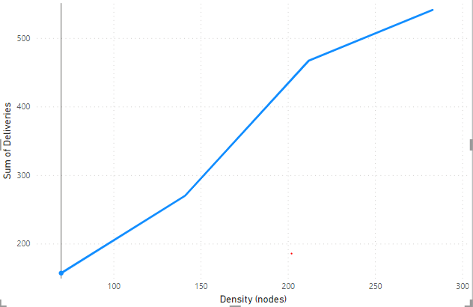
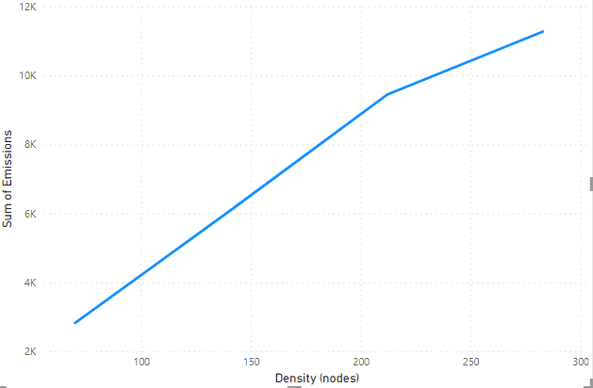
Influence of node density
03
Increasing the density:
Increases the number of packet collisions, transmission, reception, and deliveries
Density (nodes) | Collisions | Receptions | Emissions | Deliveries
70 | 8,307 | 195,912 | 2,828 | 157
141 | 62,559 | 812,905 | 6,106 | 270
212 | 315,738 | 1,704,711 | 9,445 | 467
283 | 562,700 | 2,676,558 | 11,280 | 541
13 / 16

Slide 16
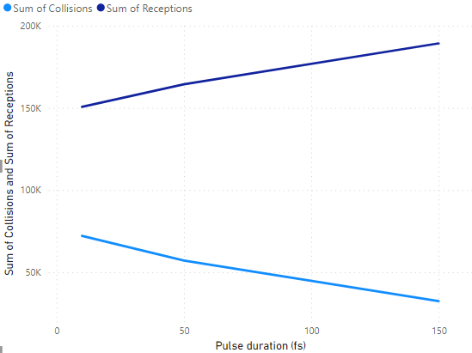
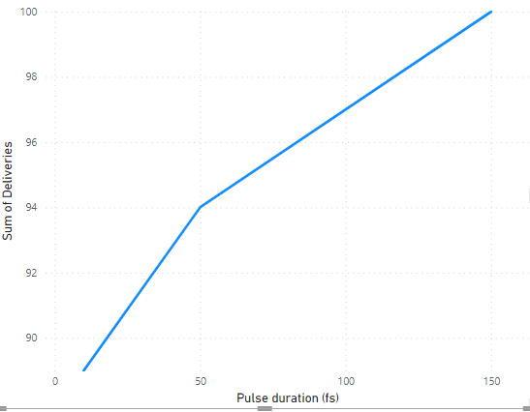
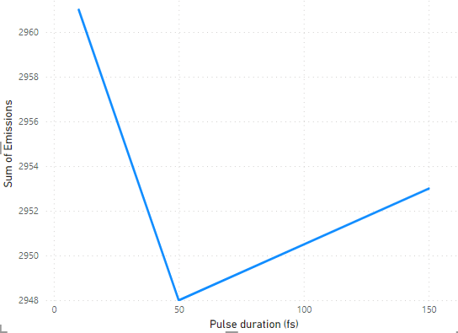
Influence of pulse duration
03
Increasing the pulse duration:
Reduces the number of packet collisions
Increases the number of packet receptions and deliveries
Pulse duration (fs) | Collisions | Receptions | Emissions | Deliveries
10 | 72,126 | 150,683 | 2,961 | 89
50 | 57,154 | 164,371 | 2,948 | 94
150 | 32,402 | 189,307 | 2,953 | 100
14 / 16

Slide 17
06
Conclusion & Future work
15 / 16
Carole Al Mawla

Slide 18
Conclusion & Future work
06
Using the perfect algorithm with bad parameters is not ideal
Choosing the optimal parameters enhances network usage
Our future work intends to cover other network parameters and protocols
Parameter | Collisions | Receptions | Emissions | Deliveries
Beta
Communication range
Density
Pulse duration
16 / 16
Carole Al Mawla

Slide 19
Thank you!!
Examples with VisualTracer
bs-scenario: bitsimulator --probability 0.02 probaflooding.xml && visualtracer
bitsimulator --probability 0.01 probaflooding.xml && visualtracer
sim: visualtracer --initialTimeSkip 10000000000, why red nodes behind and not forward?

