Slide 1
Distributed Pneumatic MEMS for fast Conveyance of Fragile Objects
November 2012
Amirali HABIBI, Eugen DEDU, Julien BOURGEOIS, Guillaume LAURENT, Nadine PIAT

Slide 2
Outline
Outline
Smart Blocks
Tasks
Object Recognition and Movement
Results
Conclusion
Smart Blocks?
Domain
Object Recognition and Movement
Results
Conclusion

Slide 3
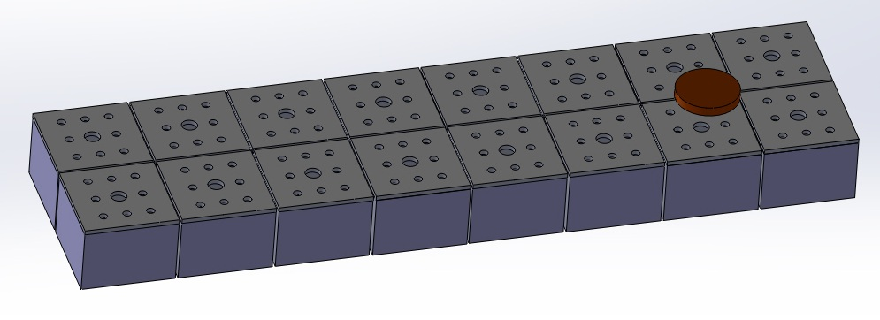
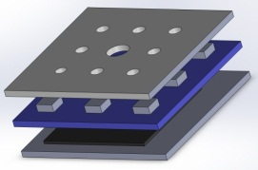
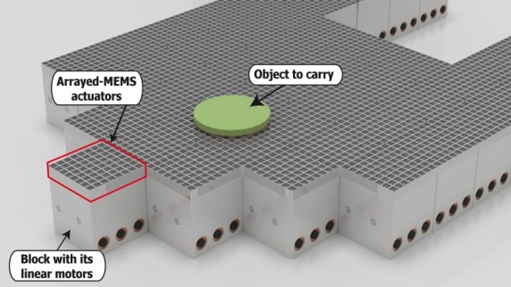
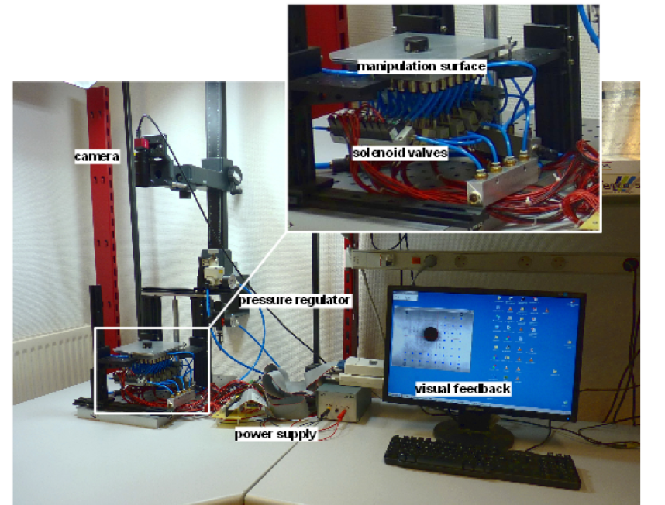
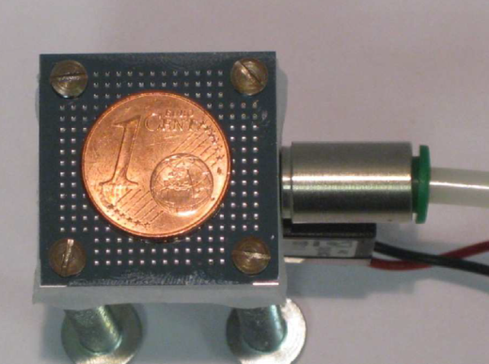
Smart Blocks Architecture
Outline
Smart Blocks
Tasks
Object Recognition and Movement
Results
Conclusion

Slide 4
Different Tasks
Outline
Smart Blocks
Tasks
Object Recognition and Movement
Results
Conclusion
Control
Fault-Tolerance
Network
Real-Time
Power
Modular
Self-Reconf
Mechanics

Slide 5
Tasks & Scheduling
Outline
Smart Blocks
Tasks
Object Recognition and Movement
Results
Conclusion
Recognition
Message Routing
Control
EDF Scheduler
Multi Object Arrival

Slide 6
Tasks & Scheduling
Outline
Smart Blocks
Tasks
Object Recognition and Movement
Results
Conclusion
Non-Periodic Tasks
EDF
Set of Tasks in block i:${τ }_{1}$, ${τ }_{2}$, … ${τ }_{i}$ … ${τ }_{n}$
Set of Communication in block i: $C=\{c_{x,y}…,c_{z,i}\}$

Slide 7
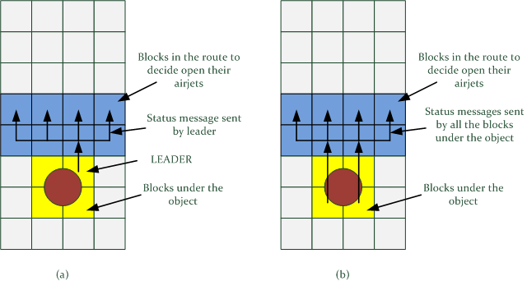
Strategies for Movement
Outline
Smart Blocks
Tasks
Object Recognition and Movement
Results
Conclusion

Slide 8
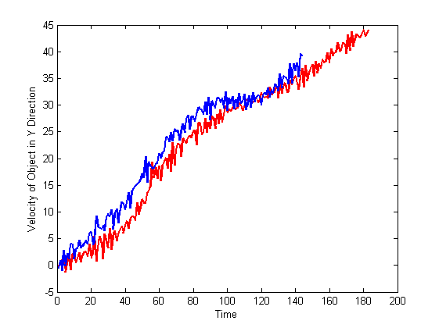
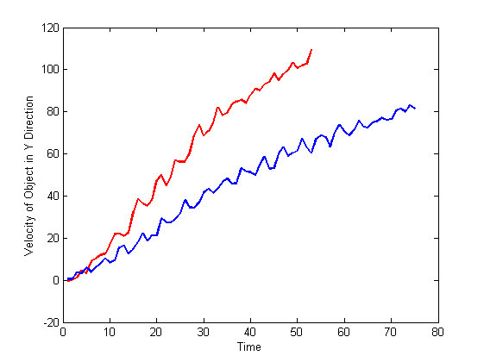
Result
Outline
Smart Blocks
Tasks
Object Recognition and Movement
Results
Conclusion

Slide 9
Conclusion
Outline
Smart Blocks
Tasks
Object Recognition and Movement
Results
Conclusion
Design
Extract the Physicals
Communication
Object Recognition and Movement

Slide 10
Questions?
We will meet in poster session
This work was supported by the Smart Blocks under the number ANR-2011-BS03-005

