Slide 1
TcpHas: TCP for HTTP Adaptive Streaming
Chiheb BEN AMEUR^{1,2}
Emanuel MORY²
Bernard COUSIN¹
Eugen DEDU³
¹IRISA, University of Rennes 1, ²Orange Labs, ³University of Bourgogne Franche-Comté
IEEE ICC 2017 Communications Software, Services, and Multimedia Applications Symposium
CSSMA-01: Multimedia Streaming and Video Delivery
Paris, 22nd May 2017
Notes:
Hello,
I am Chiheb Ben Ameur R&D Engineer at INNES. I am glad to present the paper titled TcpHas: TCP for HTTP Adaptive Streaming which is a part of my PhD in collaboration with Orange Labs, IRISA and University of Franche compté.
As the title indicates, the idea of this paper is to propose a new TCP congestion control protocol suitable for HTTP Adaptive Streaming.

Slide 2
HTTP Adaptive Streaming
Introduction TcpHas Framework Evaluation Conclusion
Storage & Streaming
1
2
3
4
Chunk request
FULL HD
HTTP
encoding bitrate
HAS Player
Web Server
FULL HD
7
8
9
10
1
2
3
4
HD
Available bandwidth
HD
11
1
2
3
4
SD
5
6
SD
1
2
3
4
12
time
Figure 1: General description of HTTP Adaptive Streaming
Chiheb Ben Ameur Orange Labs – IRISA-UBFC IEEE ICC’17-CSSMA-01 Paris 22 May 2017
Notes:
Comme le titre l’indique, le contexte de notre travail est la technologie HTTP Adaptive Streaming. Cette technologie consiste à transcoder la vidéo originale vers de multiples niveaux de qualité et à la segmenter en petit segments de même durée de lecture, appelée chunks. Ces chunks seront demandés par le player HAS situé du côté du client en utilisant le protocole HTTP. le choix du niveau de qualité est une fonction de la bande passante estimée du ou des chunks précédents, comme la figure suivante le montre.
Ici, l’intelligence est localisée au niveau du player qui …
For that, let explain briefly how HAS works in general use cases. HAS is a streaming technology where video content are stored and encoded at different qualities at the server. Each video is segmented into video segment of same duration called chunks. The player at the client side will ask periodically video chunks and selects the suitable quality level according to available resources such as the available bandwidth.

Slide 3
TCP Congestion Control Algorithm
Introduction TcpHas Framework Evaluation Conclusion
congestion detection
number of bytes
bottleneck capacity
Congestion Avoidance phase
ssthresh
Slow Start phase
cwnd
time
Figure 4: Common TCP congestion control behavior
➔ Maximizing the occupancy of bottleneck capacity
Chiheb Ben Ameur Orange Labs – IRISA-UBFC IEEE ICC’17-CSSMA-01 Paris 22 May 2017

Slide 4
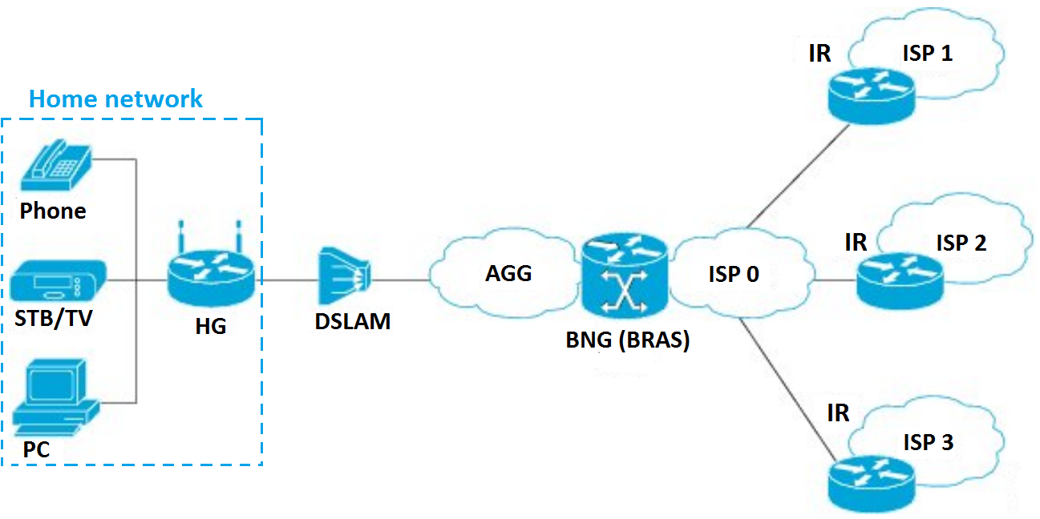
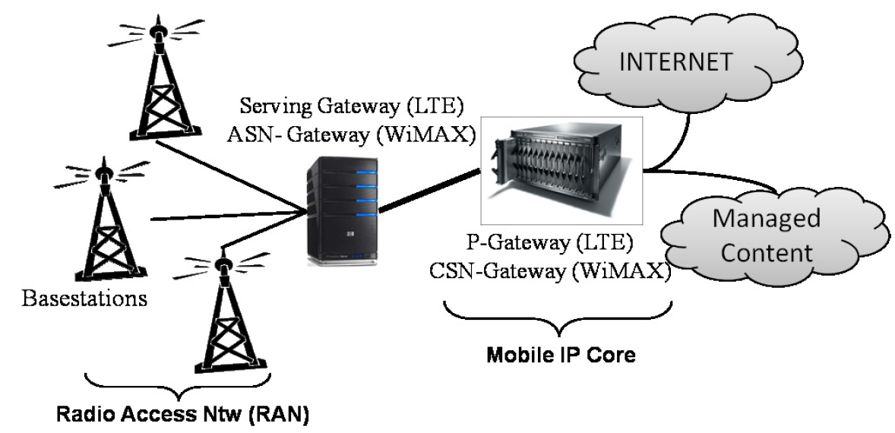
Broadband Access Network
Introduction TcpHas Framework Evaluation Conclusion
Bottleneck link
Storage & Streaming
Web Server
HAS Player
Storage & Streaming
Bottleneck link
Web Server
HAS Player
Figure 3: Fixed and mobile broadband access network architecture
Chiheb Ben Ameur Orange Labs – IRISA-UBFC IEEE ICC’17-CSSMA-01 Paris 22 May 2017
Notes:
En fait, les clients HAS sont localisées soit au sein d’un réseau d’accès fixe ou mobile, comme la figure le montre.
Sur les deux architecture, un goulot d’étranglement est plus fréquemment localisé entre le DSLAM et le Home gateway dans le réseau fixe et entre le serving gateway et le base station dans le cas d’un réseau d’accès mobile. La cause est due à la limitation de la capacité de ce lien et la taille réduite de la file d’attente au nivau du DSLAM ou du serving gateway.
Ainsi, le cas d’utilisation ou plusieurs clients HAS partagent le même goulot d’étranglement et sont localisés sur le même réseau local est de plus en plus fréquent.

Slide 5
What Happens When HAS Clients Compete ?
Introduction TcpHas Framework Evaluation Conclusion
bandwidth
Bandwidth over estimation
Congestion in the bottleneck link
HD
SD
Available bandwidth
ON
ON
FULL HD
Quality level degradation
OFF
period
Client 1
Available bandwidth
HD
SD
time
ON
ON
OFF
period
FULL HD
OFF
period
Client 2
time
Figure 5: The OFF period issue when 2 HAS clients compete for bandwidth
➔ QoE degradation
➔ QoS degradation
Chiheb Ben Ameur Orange Labs – IRISA-UBFC IEEE ICC’17-CSSMA-01 Paris 22 May 2017
Notes:
Par exemple, si on a deux clients HAS sur le même réseau domestique, et si la période ON de chaque client coincide avec la période OFF de l’autre, une surestimation de la bande passante est enregistrée sur chacun des players. Ainsi, les players vont switcher à un niveau de qualité supérieur. Si la somme du débit d’encodage des deux qualités sélectionnée est supérieure à la bande passante totale, une congestion est enregistrée et un délai supplémentaire sera nécessaire pour télécherger ces chunks. Par conséquent, la nouvelle estimation pourrait conduire à choisir un niveau de qualité encore plus bas que le premier.
Donc, ici on constate que la cause de cette dégradation est la durée des périodes OFF assez improtante.
Dans ce cas de figure, la qualité d’expérience de l’utilisateur est largement dégradée vue qu’il y a une fluctuation entre différents niveaux de qualité. En plus, une dégradation de la qualité de service du réseau d’accès est marquée par la congestion causée par cette concurrence.

Slide 6
HAS Traffic Shaping
Introduction TcpHas Framework Evaluation Conclusion
bandwidth
OFF
periods
Available bandwidth
HD
HD
HD
HD
Shaping Bitrate (SHR₁)
ON
ON
ON
ON
Client 1
Available bandwidth
time
HD
HD
HD
HD
Shaping Bitrate (SHR₂)
ON
ON
ON
ON
Client 2
time
Figure 6: HAS traffic shaping effect on HAS clients competing for bandwidth
Improving the QoE of HAS
Improving the QoS of access network
Chiheb Ben Ameur Orange Labs – IRISA-UBFC IEEE ICC’17-CSSMA-01 Paris 22 May 2017
Notes:
Comment faire face à ce problème, une solution pouvait améliorer considérablement les performances. Elle est désignée par HAS Traffic Shaping. c.a.d un bridage du débit HAS. Cette solution consiste à définir un débit maximum pour chaque flux HAS du réseau domestique qui permettra à chaque client de se stabiliser sur un niveau de qualité optimal. Dans ce cas, les périodes ON s’étalent et les périodes OFF se réduisent. Ainsi, le player HAS pouvais surmonter les limitations générées par la période OFF.
C’est ic que nous définissons l’objectif de notre travail: c’est d’appliquer le HAS traffic shaping mais, en optimisant le protocole TCP pour cet objectif, vue que le ce protocole n’est pas adaptée au service du HAS.

Slide 7
Objectives of this paper
Introduction TcpHas Framework Evaluation Conclusion
Improving QoE of HAS
Improving QoS of access network
Methodology
Optimizing TCP protocol and applying traffic shaping
TcpHAS: HAS-Based Congestion Control Variant
Server-based Shaping Method implemented in TCP layer
Chiheb Ben Ameur Orange Labs – IRISA-UBFC IEEE ICC’17-CSSMA-01 Paris 22 May 2017

Slide 8
HAS Traffic Shaping on the server side
Introduction TcpHas Framework Evaluation Conclusion
Based on two modules:
Optimal video quality level estimation (from BW estimation)
Shaping the sending rate (according to optimal quality encoding rate)
How to implement modules in TCP layer ?
BW estimation from TCP congestion control algorithm: TCP adaptive decrease variants: Westwood, Westwood+, TIBET.
Shaping the sending rate by changing the TCP sending window size:
Trickle*: [YouTube 2011, in progressive download technology]
Places a dynamic upper bound on the congestion window (cwnd) ➔TCP limits the overall data rate.
Periodically computes the cwnd bound from the round-trip time (RTT) and the target streaming bitrate ($RTT × targetBitRate)$
*GHOBADI, M., CHENG, Y., JAIN, A., AND MATHIS, M. Trickle: Rate limiting youtube video streaming. In Usenix Annual Technical Conference (2012), pp. 191–196
Chiheb Ben Ameur Orange Labs – IRISA-UBFC IEEE ICC’17-CSSMA-01 Paris 22 May 2017

Slide 9
Overview
Introduction TcpHas Framework Evaluation Conclusion
Introduction
TcpHas Description
Framework
TcpHas Evaluation
Conclusion and Future Work
Chiheb Ben Ameur Orange Labs – IRISA-UBFC IEEE ICC’17-CSSMA-01 Paris 22 May 2017

Slide 10
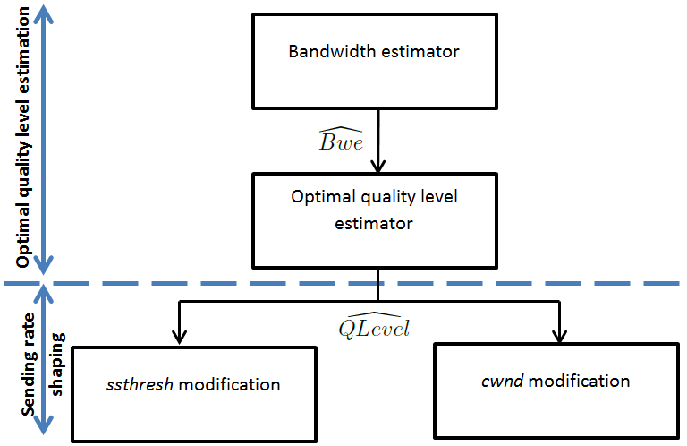
TcpHas Overview
Introduction TcpHas Framework Evaluation Conclusion
Application layer
available video quality levels
1. How is configured ?
➔TIBET, better than
Westwood: ACK compr. & cluster.
Westwood+: dependent to cwnd
2. Update frequency ?
TCP layer
- After congestion detection
- After OFF periods > RTO
- Initialization (highest quality)
3. ssthresh value?
4. cwnd value?
Figure 7: Basic idea of TcpHas
Chiheb Ben Ameur Orange Labs – IRISA-UBFC IEEE ICC’17-CSSMA-01 Paris 22 May 2017

Slide 11
Overview
Introduction TcpHas Framework Evaluation Conclusion
Introduction
TcpHas Description
Framework
TcpHas Evaluation
Conclusion and Future Work
11
Chiheb Ben Ameur Orange Labs – IRISA-UBFC IEEE ICC’17-CSSMA-01 Paris 22 May 2017

Slide 12
Simulations
Introduction TcpHas Framework Evaluation Conclusion
Network simulator ns-3:
Fixed broadband access network
Drop Tail algorithm
queue length = BW×delay
S₀
S₁
LAN/WLAN 192.168.0.0/24
CSMA 100 Mbps
HG
Bottleneck link
DSLAM
BNG
IR
NetLink
DSLLink
AggLine
ISPLink
8 Mbps
2ms
10 Gbps
2 ms
100 Mbps
2 ms
HAS servers
100 Mbps
RTT – 6 ms
100 Mbps
2 ms
Internet traffic emulation
PPBP overall bitrate of 40 Mbps
100 Mbps
2 ms
C₀
C₁
C_{N-2}
C_{N-1}
S_{N-2}
S_{N-1}
HAS clients
Emulated HAS players
PPBP sink
PPBP source
Poisson Pareto Burst Process
HAS module
Figure 8: Network architecture used in ns-3
Chiheb Ben Ameur Orange Labs – IRISA-UBFC IEEE ICC’17-CSSMA-01 Paris 22 May 2017

Slide 13
Overview
Introduction TcpHas Framework Evaluation Conclusion
Introduction
TcpHas Description
Framework
TcpHas Evaluation
Conclusion and Future Work
13
Chiheb Ben Ameur Orange Labs – IRISA-UBFC IEEE ICC’17-CSSMA-01 Paris 22 May 2017

Slide 14
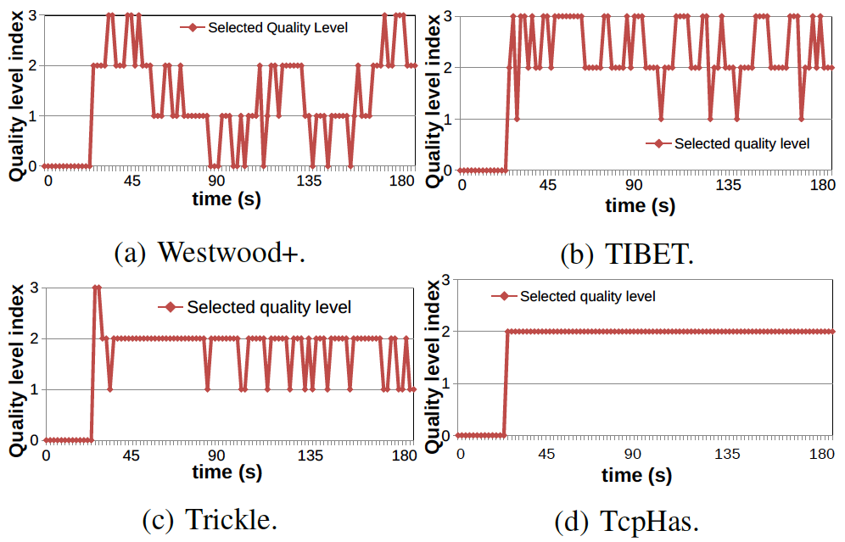
TcpHas Evaluation
Introduction TcpHas Framework Evaluation Conclusion
Figure 9: Quality level selection over time
Chiheb Ben Ameur Orange Labs – IRISA-UBFC IEEE ICC’17-CSSMA-01 Paris 22 May 2017

Slide 15
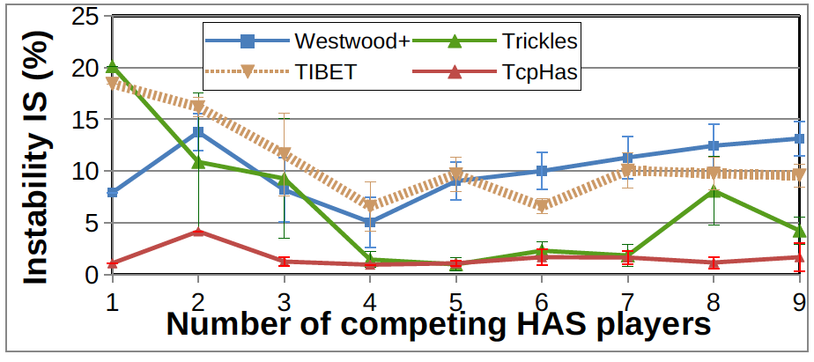
TcpHas Evaluation: QoE
Introduction TcpHas Framework Evaluation Conclusion
Figure 10: Quality level instability measurements when increasing the number of competing players
➔ TcpHas reduces the instability of video quality level
Chiheb Ben Ameur Orange Labs – IRISA-UBFC IEEE ICC’17-CSSMA-01 Paris 22 May 2017

Slide 16
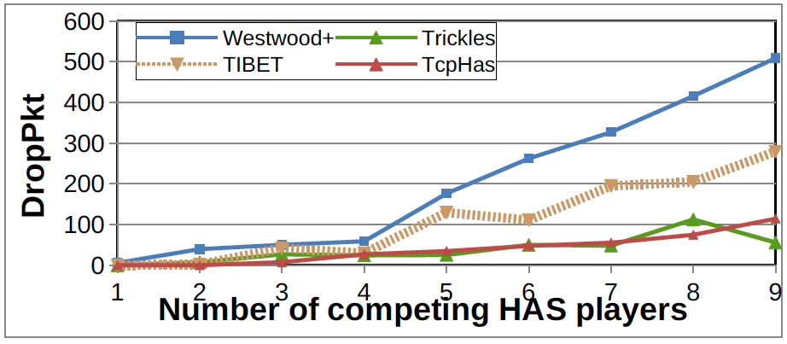
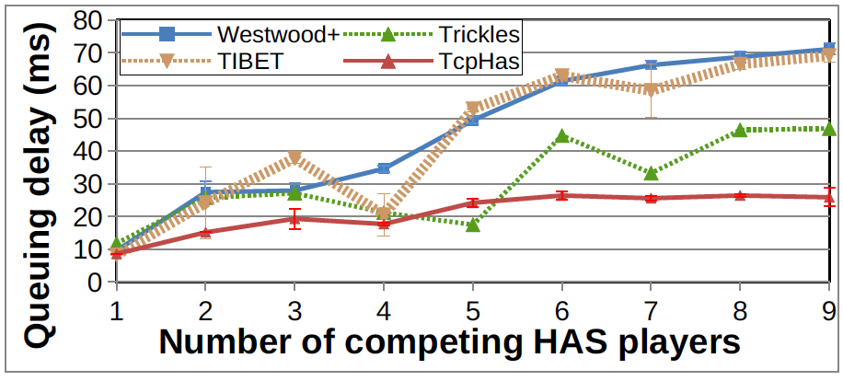
TcpHas Evaluation: QoS
Introduction TcpHas Framework Evaluation Conclusion
(a) Packet drop rate
(b) Queuing delay
Figure 12: QoS measurements when increasing the number of competing players
➔ TcpHas reduces the queuing delay and the packet drop rate in the bottleneck link
Chiheb Ben Ameur Orange Labs – IRISA-UBFC IEEE ICC’17-CSSMA-01 Paris 22 May 2017

Slide 17
Overview
Introduction TcpHas Framework Evaluation Conclusion
Introduction
TcpHas Description
Framework
TcpHas Evaluation
Conclusion and Future Work
Chiheb Ben Ameur Orange Labs – IRISA-UBFC IEEE ICC’17-CSSMA-01 Paris 22 May 2017
Notes:
dire que les perfs de westwood+ se dégradents lors de l’augmentation du nombre des flux HAS

Slide 18
Conclusion and Future Work
Introduction TcpHas Framework Evaluation Conclusion
TcpHas: HAS-based TCP Variant
A novel server-based shaping method totally implemented in TCP layer
Requires the knowledge of the encoding bitrates of available quality levels
Inspired from TIBET to estimate available bandwidth
updates ssthresh when detecting a congestion event or after an idle period, and modifies cwnd during congestion avoidance phase.
Improves:
QoE of HAS (stability, optimal quality selection)
QoS of access network (less packet drop rate, less queueing delay)
Future Work
Live streaming service and unstable network conditions
Real software and networks.
Chiheb Ben Ameur Orange Labs – IRISA-UBFC IEEE ICC’17-CSSMA-01 Paris 22 May 2017

Slide 19
Thank you for your attention
Questions ?
Chiheb Ben Ameur Orange Labs – IRISA-UBFC IEEE ICC’17-CSSMA-01 Paris 22 May 2017

Slide 20
Emulated HAS Player
Annexe
Why an emulated player ?
less complexity
more accurate evaluation
QoE objective criteria
adequate for testbeds and simulations
Description
rate and buffer based (RBB) player
playback buffer length B_{C} = 30 seconds
chunk duration: 2 seconds
aggressiveness σ :
HTTP/1.1 with persistent connection
Chiheb Ben Ameur Orange Labs – IRISA Rennes 17 décembre 2015

Slide 21
ON-OFF pattern
Annexe
throughput
HD
FULL HD
bandwidth estimation
FULL HD
HD
HD
HD
HD
available
bandwidth
SD
OFF period
ON period
ON
OFF
OFF
ON
OFF
ON
ON
ON
ON
OFF
OFF
OFF
time
T: chunk duration
t
t+T
t+6T
t+2T
t+3T
t+4T
t+5T
t+7T
t+8T
Buffering
State
Steady State
Figure 2: ON and OFF periods of HAS stream
Chiheb Ben Ameur Orange Labs – IRISA-UBFC IEEE ICC’17-CSSMA-01 Paris 22 May 2017
Notes:
Ainsi, le player dans le cas commun fonctionne comme suit:
On distingue la première phase de buffering au cours de laquelle le player demande les chunks successivement afin de remplir le playback buffer au plus vite. Un fois bien remplie, il bascule vers la phase de steady state au cours de laquelle il demande un chunk chaque durée de chunk. En conséquent, on distingue les périodes ON au cours de laquelle le client est en train de télécharger le chunk, et la période OFF qui est une période de repos entre deux périodes ON successives. Ici on note une limitation de HAS vue que contrairement aux périodes ON, durant la période OFF le Player ne pouvait pas estimer la bande passante.
En plus
Néamnmoins, ce comportement peut se complexifier encore dans le cas d’usage quotidient.

Slide 22
Motivation
Introduction TcpHas Framework Evaluation Conclusion
HTTP Adaptive Streaming: OFF period issue
➔ Shrinking OFF periods and expending ON periods are needful
➔HAS traffic shaping
TCP Congestion Control Algorithm
in HAS server
Combination*
Congestion
window validation reduces QoE and QoS
- is aggressive
- maximizes BW occupancy
- is independent to video
encoding bitrates
➔ not well-adapted to HAS
ssthresh positionning should be optimized
(convergence speed
+
congestion rate)
TcpHAS: HAS-Based Congestion Control Variant
Server-based Shaping Method implemented in TCP layer
*C. Ben Ameur, E. Mory, and B. Cousin, “Combining traffic shaping methods with congestion control variants for HTTP adaptive streaming,” Multimedia Systems, pp. 1–18, 2016.
Chiheb Ben Ameur Orange Labs – IRISA-UBFC IEEE ICC’17-CSSMA-01 Paris 22 May 2017
Notes:
not well-adapted to streaming

Slide 23
1. Bandwidth Estimation Scheme of TCP
Annexe: TcpHas
ACK compression
ACK clustering
Westwood
Westwood+
TIBET
Bandwidth estimator
Low pass filter
ACK reception
reduces ACK compression effect
reduces ACK clustering effect
is dependent to min(rwnd,cwnd)
sender
reduces ACK compression effect
reduces ACK clustering effect
is less dependent to min(rwnd,cwnd)
sender
ACK_{n}
ACK_{n}
t_{n}
ACK_{n+1}
low-pass filter
ACK_{n+X}
RTT
t_{n+1}
low-pass filter
Chiheb Ben Ameur Orange Labs – IRISA-UBFC IEEE ICC’17-CSSMA-01 Paris 22 May 2017

Slide 24
2. Optimal quality level estimator
Annexe: TcpHas
bitrate
EncodingRate(i+1)
Bwe
QLevel
EncodingRate(i)
Chiheb Ben Ameur Orange Labs – IRISA-UBFC IEEE ICC’17-CSSMA-01 Paris 22 May 2017

Slide 25
3. Ssthresh modification
Annexe: TcpHas
Inspired from adaptive decrease mechanism
Shaping rate 20% higher than encoding rate *
Ssthresh updating
Congestion detection [inspired from adaptive decrease mechanism]
After period [and deactivation of congestion window validation]
Initialization after connection establishment [the highest quality level]
*GHOBADI, M., CHENG, Y., JAIN, A., AND MATHIS, M. Trickle: Rate limiting youtube video streaming. In Usenix Annual Technical Conference (2012), pp. 191–196
Chiheb Ben Ameur Orange Labs – IRISA-UBFC IEEE ICC’17-CSSMA-01 Paris 22 May 2017

Slide 26
4. Cwnd modification
Annexe: TcpHas
Traffic shaping during congestion avoidance phase
Shaping bitrate
Taking into account RTT increase
Mitigating RTT fluctuation
Chiheb Ben Ameur Orange Labs – IRISA-UBFC IEEE ICC’17-CSSMA-01 Paris 22 May 2017

Slide 27
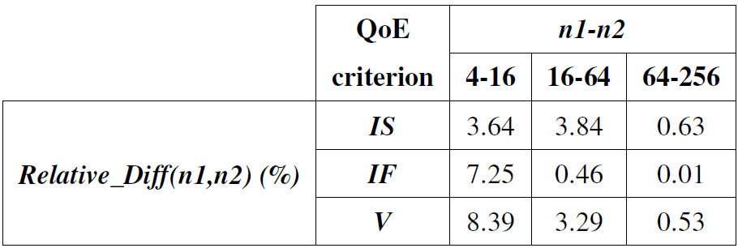
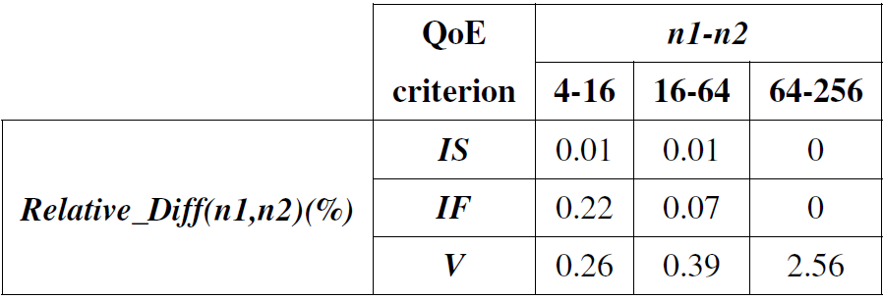
Relative Difference between two Mean Values
Annexe
W/o (Westwood+)
TcpHas
0.45
0.01
0.02
0.01
1.5
Chiheb Ben Ameur Orange Labs – IRISA Rennes 17 décembre 2015

Slide 28
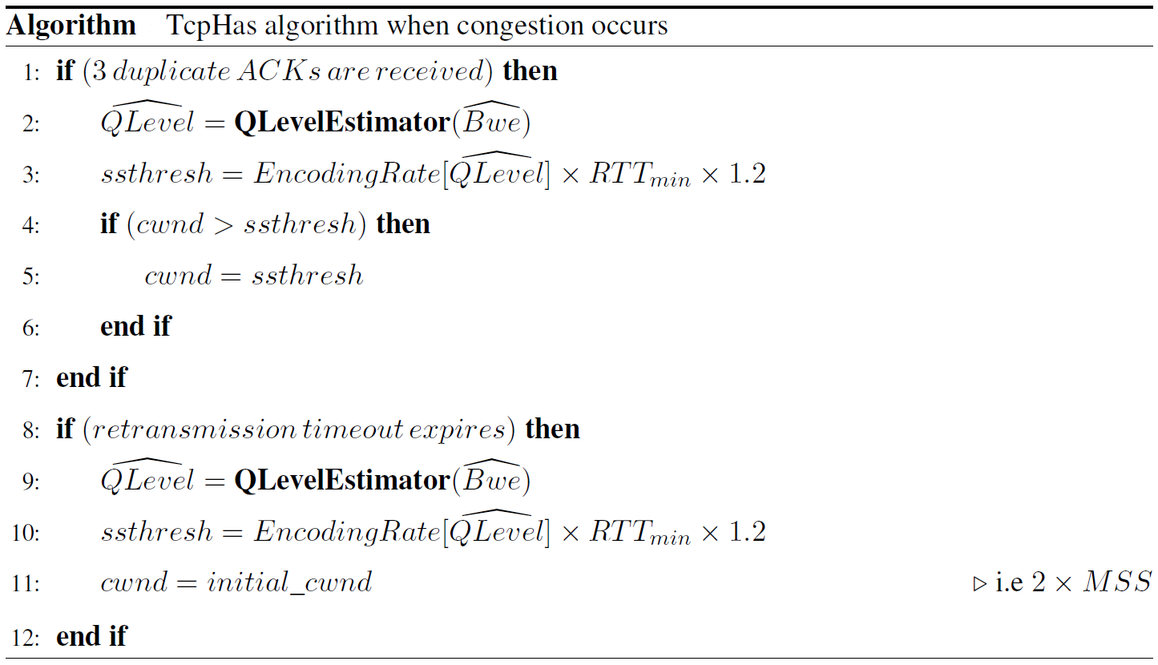
3. Ssthresh modification
Annexe
i. Congestion detection
Chiheb Ben Ameur Orange Labs – IRISA Rennes 17 décembre 2015

Slide 29
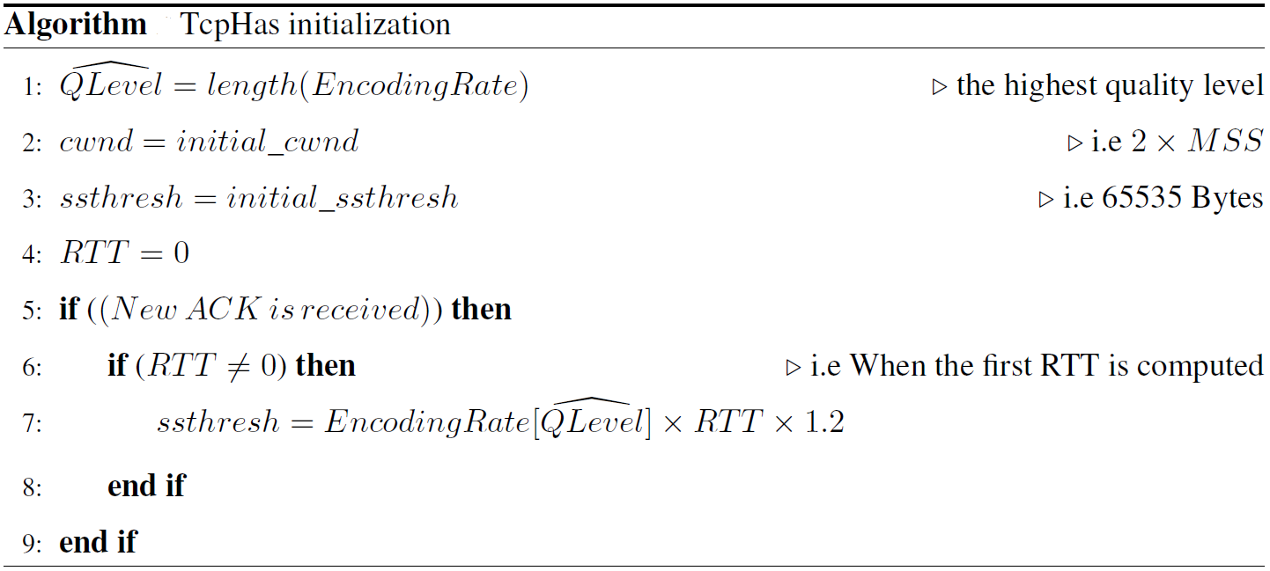
3. Ssthresh modification
Annexe
ii. After period: idle period > RTO
iii. initialization
Chiheb Ben Ameur Orange Labs – IRISA Rennes 17 décembre 2015

Slide 30
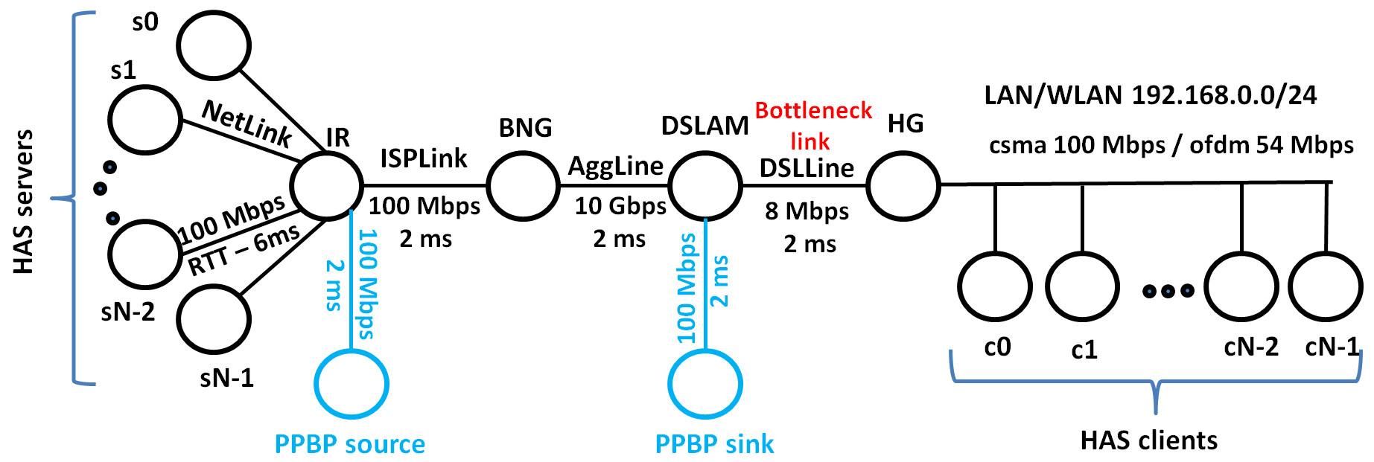
TcpHas Evaluation
Annexe
ns-3 simulator
Comparison with Westwood+
[adaptive decrease mechanism]
Optimal quality level
Various conditions:
Effect of increasing the number of HAS flows (1 flow ➔9 flows)
Better QoE than Westwood+: no stalling events, Iow instability < 4%
Better QoS than Westwood+: low queuing delay + no packet drop+ high BW occupancy
Playback Buffer size effect (6 seconds ➔ 30 seconds)
Better QoE than Westwood+: lower stalling events
Better QoS than Westwood+: lower queuing delay (<15 ms vs.> 25 ms) + no packet drop
Chiheb Ben Ameur Orange Labs – IRISA Rennes 17 décembre 2015
Notes:
dire que les perfs de westwood+ se dégradents lors de l’augmentation du nombre des flux HAS

Slide 31
TcpHas Evaluation
Annexe
Chunk duration effect (2 seconds ➔ 7 seconds)
Better QoE than Westwood+: higher bandwidth occupancy when chunk duration > 4 s
Better QoS than Westwood+: lower queuing delay and negligible packet drop rate
Initial round-trip propagation delay effect (25 ms ➔ 200 ms)
Better QoE and QoS than Westwood+ + Higher BW occupancy when RTT⁰_{C-S} > 125 ms
IP traffic effect (PPBP traffic: 20% ➔ 100% of ISP capacity)
Better QoE and QoS than Westwood+ when PPBP traffic < 70% of ISP capacity
Sensitivity to high IP traffic when PPBP traffic > 70% of ISP capacity [higher stalling events]
Bottleneck queue effect (DropTail / RED + queue length)
Better QoE and QoS than Westwood+
RED is safer for TcpHas when queue length < BW×Delay/2
Chiheb Ben Ameur Orange Labs – IRISA Rennes 17 décembre 2015
Notes:
la cause de dégradation de TcpHas lorsque IP traffic > 70%: TcpHas est sensible au taux de congestion élevé: il mettra à jour la qualité optimale ainsi que ssthresh et il aura un comportement instable.

