Slide 1
Tree-structured knowledge in a distributed intelligent MEMS application
¹⁾Atsushi Sato, ²⁾Eugen Dedu, ²⁾Julien Bourgeois, ¹⁾Runhe Huang
¹⁾Hosei University, ²⁾UFC/FEMTO-ST

Slide 2
Table of Contents
Introduction
Smart Surface
Main issues
Theory
Tree-structured knowledge (TSK)
Reconstruction of the object with TSK
Differentiation of the object with TSK
Analyses
Conclusions and future work

Slide 3
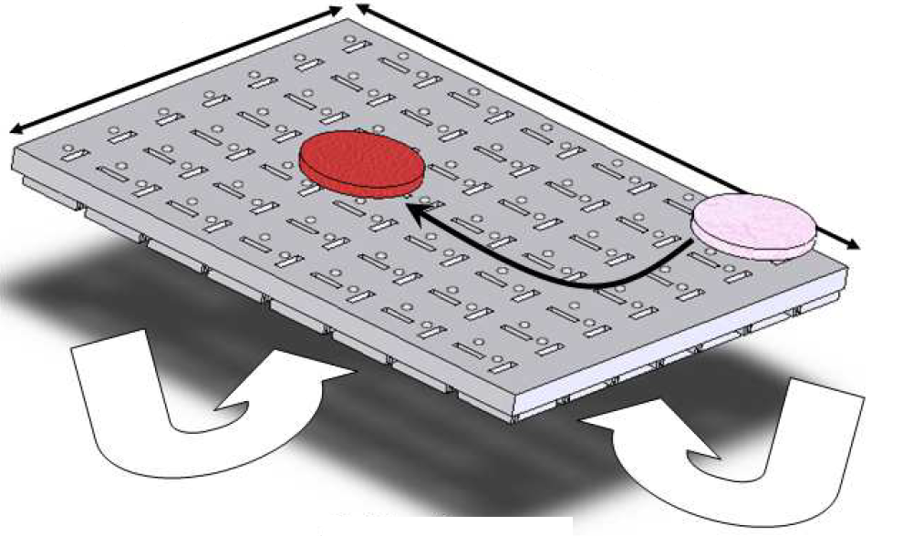
Smart Surface
MEMS-arrayed manipulation surface
Recognition
Conveyance
Positioning
35mm
35mm
Air-Flow Pressure

Slide 4
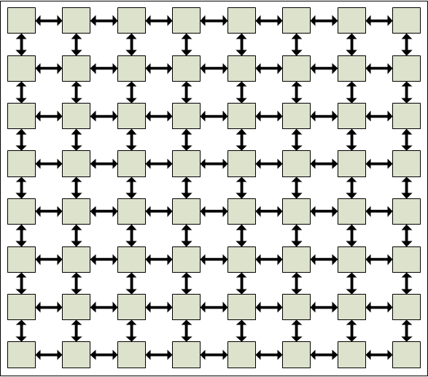
Distributed control
MEMS
Sense
Act
Decide
Communicate
MEMS

Slide 5
Recognition
Offline stage
Create database of shapes of models
Online stage
Reconstruction
Differentiation
?

Slide 6
Offline stage
( the previous approach )
Repeat
Matrix
Criteria
Database
0010
0111
1110
0100
A: 10
P: 16
S: 8
Model data
…
Rotate and translate
the object on the Smart Surface
Database is uploaded to every cell

Slide 7
Online stage
( the previous approach )
Repeat
Reconstruction phase
00000000
00000000
01000000
00000000
00000000
00000000
00000000
00000000
00000000
01100000
01000000
00000000
00000000
00000000
00000000
00100000
01110000
11100000
01000000
00000000
00000000
Differentiation phase
Calculate criteria
Compare with database
failure
success

Slide 8
Main issues
Message size is the same as the Smart Surface
-> redundant
excessively comparison
-> there is no trigger
Relative position based representation

Slide 9
Tree-structured knowledge
( our current approach )
root node
N’
W’
N
E’
N
W
S
E
W
E
S
N’
W’
E’
Smart Surface

Slide 10
Tree-structured array
1
1
0
1
0
0
0
0
0
0
1
0
0
0
Smart Surface
1 1 0 0 0 0 1 0 0 1 0 0 0 0
1
1
1
1

Slide 11
Matrix VS. TSK
Matrix
Tree-Structured Array
00000000
00000000
01100000
01000000
00000000
00000000
00000000
64 bits
10010001000
11 bits
00000000
00100000
01110000
11100000
01000000
00000000
00000000
64 bits
100110011000100010001000
24 bits

Slide 12
Reconstruction
Repeat
Initialize its array
Generate and send messages
Receive and merge messages
Check duplication
Differentiation phase

Slide 13
Generate messages
1 1 0 0 0 0 1 0 0 1 0 0 0
1 1 0 0 0 0 1 0 0 1 0 0 0
1 0 0 0
0 0 1 0 0 1 0 0 0
1
1
1
1
1 1 0 0 0 0 0

Slide 14
Merge messages(1/3)
Message size : 1 bit

Slide 15
Merge messages(2/3)
Message size : 4 bits

Slide 16
Merge messages(3/3)
All leaf values are 0
Go to
differentiation phase

Slide 17
Duplication check
1 0 0 0 0
1 0 0 1 1
1 0 0 1 0 0 1 1 0 1 0
Smart Surface
1 0 0 1 0 0 1 1 0 0 0

Slide 18
Differentiation
Transform its tree to the regular form
Repeat
Change the root to the north
Change the root to the west
Until the root is most northern and western
Compare the array with all the shapes in database
if (discover the same array)
Send the result to the motion controller
else
Restart the online stage

Slide 19
Transformation (1 / 2)
Change the root to the north cell
1
1 0 0
0
0 1 0 0 1 0 0 0 0

Slide 20
Transformation (2 / 2)
Change the root to the west cell
1 0
1 1 1 0 0 0 0 0 0 0
0 0

Slide 21
Comparison
Database
Compare
shape model
10001001001000 2
10001010000 0
10001110000000 1
10010001000 2
10010100100000 2
10010101000000 1
10010100100000
Models
L
0 1 2

Slide 22
Performance analyses
Number of communication iterations
Communication traffic
Computation time
Memory footprint

Slide 23
The number of communication iterations : $N$
Iteration
0
8
Iteration
0
1
5
2
3
4
5
6
7
1
2
3
4
Edge cells need more
communications
Central cells need fewer communications
$$\frac{height+width}{2}+1≤ N ≤height+width−1$$

Slide 24
Communication traffic
Matrix
$10×10×4×4×4=6400$bits
The number of
communication iterations
$$×\frac{1}{18}$$
Smart Surface
10 x 10
Tree-structured array
$\left(1+4+7+10\right)×4×4=352$bits
The number of
messages at a time
The number of
active cells
$$×$$

Slide 25
Computation time
Proposed approach
$$T=\sum_{i=1}^{N_{Reconstruction}}{{TR}_{i}}+\sum_{j=1}^{N_{Transform}}{{TT}_{j}}+\sum_{k=1}^{N_{Comparison}}{{TC}_{k}}$$
Previous approach
$$T′=\sum_{i=1}^{{N′}_{Reconstruction}}{\left({TR′}_{i}+{TA}_{i}+\sum_{j=1}^{{N′}_{Comparison}}{{TC′}_{ij}}\right)}$$
Reconstruction time (TR)
Transformation time (TT)
Comparison time (TC)
Computation time (TA)

Slide 26
Memory footprint(1/2)
Previous approach
One shape needs 29 bytes $(≅\frac{15×15}{8})$
$29×N_{Shape}$ bytes for matrices
One criterion needs 4 bytes
$4×N_{Criteria}$ bytes for criteria
Total Memory for models is :
$$M=29×N_{Shape}+4×N_{Criteria}$$

Slide 27
Memory footprint(2/2)
Proposed approach
One shape needs:
${MS}_{i}=3n+2$ bits
$n$ is the number of cells covered by the object
Total Memory for models is :
$$M=\sum_{i=1}^{N_{Shapes}}{{MS}_{i}}$$
$n$ is 22, ${MS}_{i}=68$ bits

Slide 28
Simulation of the offline stage(1/2)
Circle : 48 shapes
Rectangle : 248 shapes
H : 428 shapes
Criteria : 58
724 shapes
MEMS
Models
Every model covers less than 25 cells

Slide 29
Simulation of the offline stage(2/2)
Previous approach
$$M=29×N_{Shape}+4×N_{Criteria}$$
$$=29×724+4×58$$
$=21228$ bytes
Proposed approach
$$M=\sum_{i=1}^{N_{Shapes}}{{MS}_{i}}$$
${MS}_{i}=3×25+2$ bits
$≅10$ bytes
$$≅10×724$$
$=7240$ bytes

Slide 30
reduction of the memory footprint
724 shapes are too many to store in every cell
Include the shape appearing rarely
Reduce the stored shapes
The number of shapes
fewer
many
the probability
of matching
low
high

Slide 31
Conclusions and future work
Representing the shapes as tree-structured array reduces their memory footprint and redundant information in messages.
The number of shapes can be reduced, but it trades off with the probability of the successful differentiation.
Reduction of the number of shapes to be stored in every cell.

