Slide 1


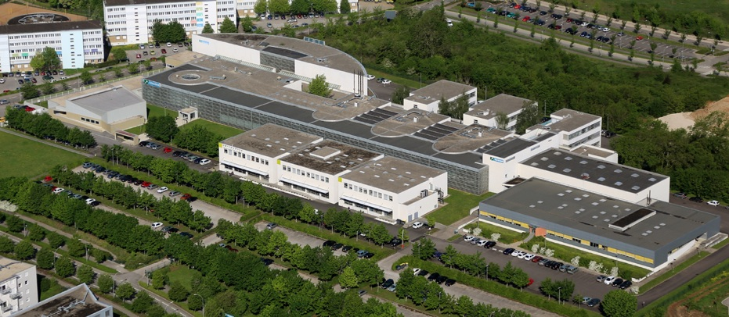




Hybrid Prognostic Approach for Micro-Electro-Mechanical Systems
Haithem Skima, Kamal Medjaher, Christophe Varnier, Eugen Dedu and Julien Bourgeois
haithem.skima@femto-st.fr
FEMTO-ST Institute, Besançon – France

Slide 2
Outline
Introduction
State of the art
PHM of MEMS
Simulation results
Conclusion and perspectives
H. Skima, K. Medjaher, C. Varnier, E. Dedu, J. Bourgeois, IEEE Aerospace Conference, March 7-14, 2015

Slide 3

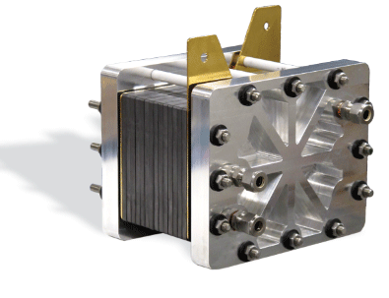
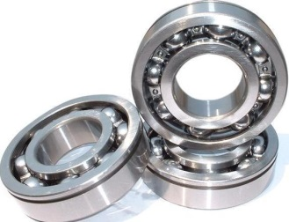
Introduction
Prognostics & Health Management (PHM)
Process that monitors systems, assesses their health state, detects and diagnoses their faults, anticipates the time to failures by calculating the remaining useful life (RUL) and takes appropriate decisions accordingly.
RUL
Health Indicator
Failure threshold
Examples of application
Time (t)
tc
tf
Micro-Electro-Mechanical Systems (MEMS)
A MEMS is a micro-system that integrates mechanical components using electricity as source of energy in order to perform measurement functions and / or operating in structure having micrometric dimensions.
Introduction State of the art PHM of MEMS Simulation results Conclusion

Slide 4

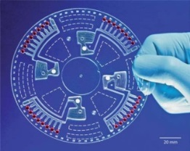




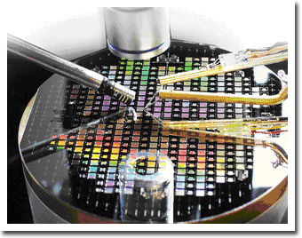
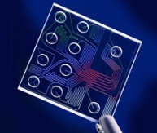
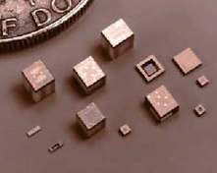
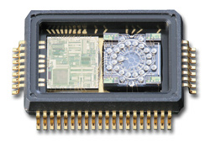
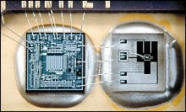
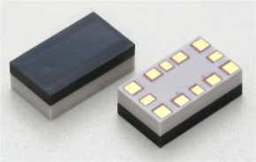
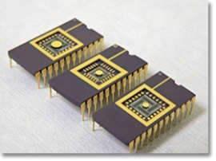
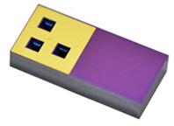

Introduction
Applications: Automotive, aerospace, biomedical, optical, fluidic, communication technologies…
Categories of MEMS
Categories of MEMS
Bio MEMS
Micro sensors
Micro actuators
RF MEMS
MOEMS
Others
Introduction State of the art PHM of MEMS Simulation results Conclusion

Slide 5

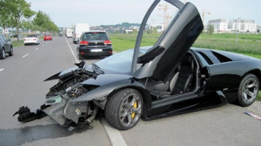



Introduction
Motivation
Reliability issues
Degradations: loss of performances
Faults: non delivered services / non achieved functions
→ risk of accidents
PHM of MEMS
Improve the reliability and availability of systems containing MEMS
Avoid failures
Reduce maintenance costs
Introduction State of the art PHM of MEMS Simulation results Conclusion

Slide 6
State of the art
Failure mechanisms
Mechanical, electrical and material based failure mechanisms
Mechanical | Electrical | Material
Delamination, Fracture, Fatigue, Creep, Stiction, Plastic-deformation, Adhesion | Degradation of dielectrics, Electrostatic discharge ESD Electro-migration, Electrical short Circuit, Electrical stiction | Stiction, Contamination
[H. R. Shea, M. McMahon et al., J. Ruan et al., R. Mûller-Fiedler et al.]
Failure mechanisms related to manufacturing or to utilization
Related to utilization | Related to manufacturing
Stiction, Delamination, Fatigue, Creep, Fracture, Adhesion, ESD, Electro-migration, Electrical short circuit | Stiction, Contamination, Fracture, Electrical short circuit
[M. MATMAT 2010]
Influence factors: temperature, humidity, vibration, noise, dust, shocks, overcharges …
Introduction State of the art PHM of MEMS Simulation results Conclusion

Slide 7
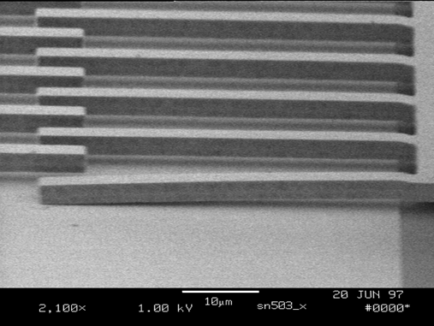
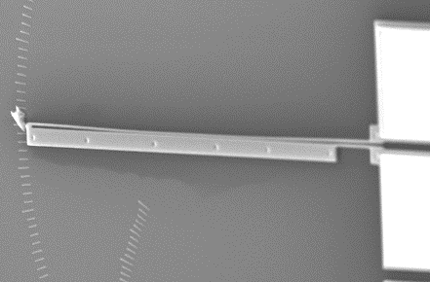
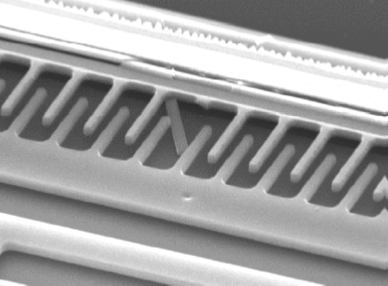
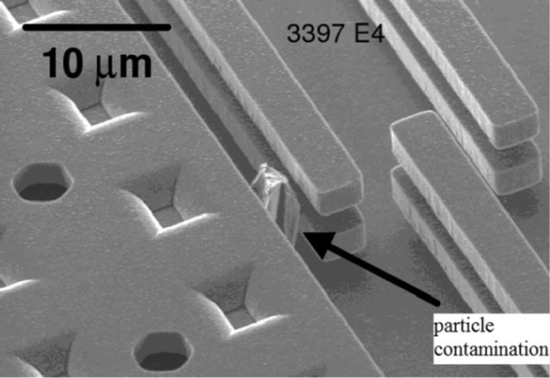
State of the art
Failure mechanisms
Stiction of the finger on the substrate [Tanner et al.]
Stiction in electro-thermal actuator
[M. Dardalhon]
Micro-actuator finger fracture
[ B. Charlot]
Contamination in a comb-drive [Tanner et al.]
Introduction State of the art PHM of MEMS Simulation results Conclusion

Slide 8
State of the art
Reliability of MEMS
Identification and understanding of failure mechanisms
Design and fabrication of MEMS
Testability and characterization of MEMS
Accelerated life tests to develop reliability models
Statistical studies of failures on a significant number
of samples
Design, fabrication and packaging optimization
Introduction State of the art PHM of MEMS Simulation results Conclusion

Slide 9
State of the art
Reliability limitations
Given conditions and period of time
The predictive reliability models are obtained from statistical data
      Significant number of samples
      Reliability models are not personalized for each MEMS and therefore there is no update of the model parameters during their utilization
PHM
Assess the health state of the MEMS at any time (Health assessment)
Predict the Remaining Useful Life (RUL) by taking into account the current and the future conditions
Update the degradation models parameters based on monitoring data
    Anticipate failures in a system based on MEMS and optimize decision making
Introduction State of the art PHM of MEMS Simulation results Conclusion

Slide 10
PHM of MEMS
Synoptic of the proposed approach
Construction of the nominal behavior model
&
Health assessment and prediction
&
RUL estimation
Generation of the degradation model
Definition of the failure thresholds
Decision making
Operating conditions
Introduction State of the art PHM of MEMS Simulation results Conclusion

Slide 11
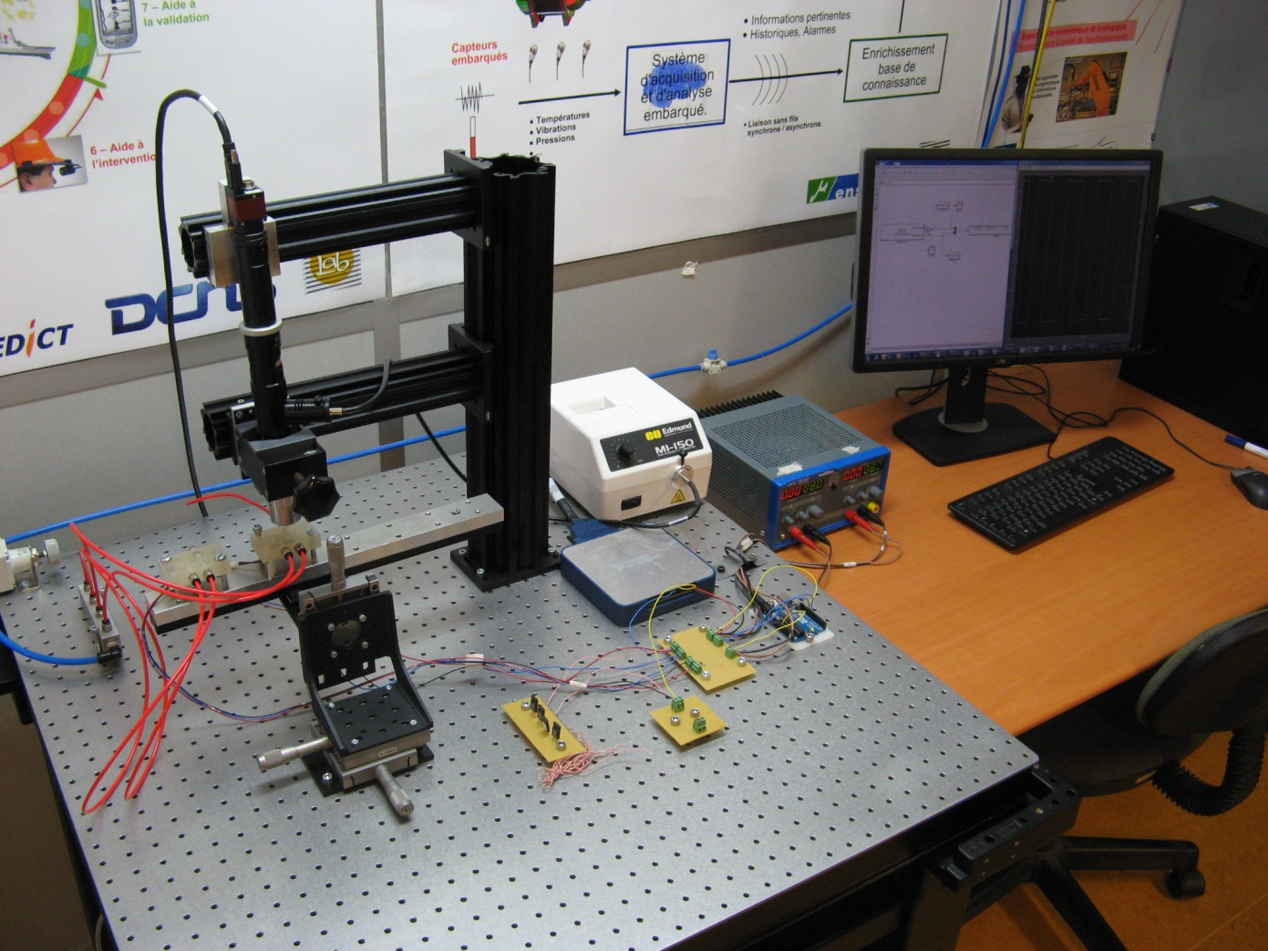
PHM of MEMS
Experimental platform
Light source
Computer
Camera
Voltage supplier
MEMS
Arduino
Anti-vibration table
Resistors
NI card
Introduction State of the art PHM of MEMS Simulation results Conclusion

Slide 12
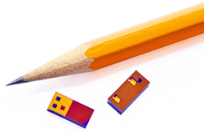
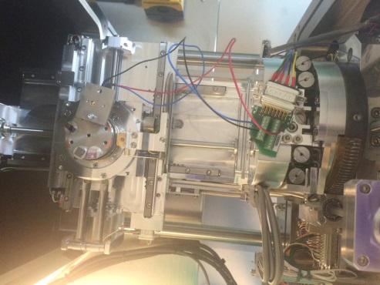
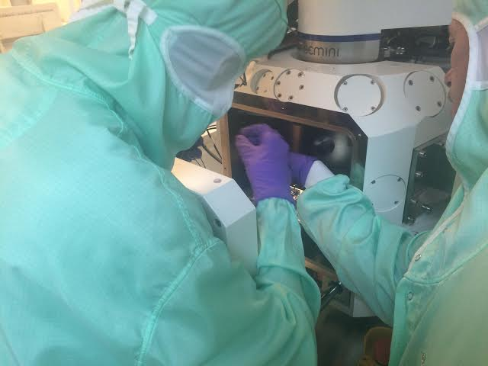
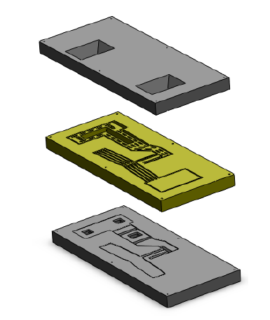
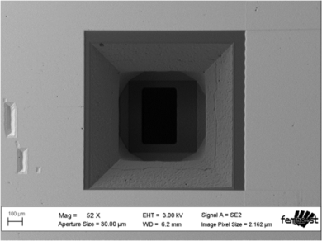
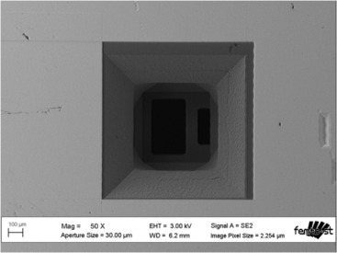
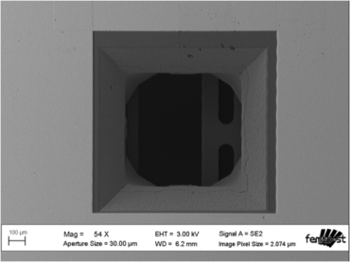
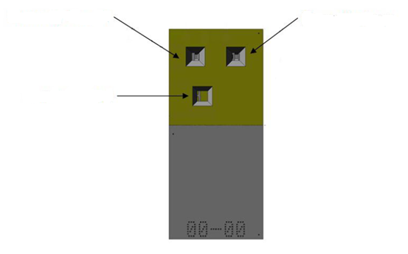
PHM of MEMS
MEMS valve
Designed to control flow rates or pressure with high precision and with fast response time
Electrical connections
Movable membrane
Fluid connection ports
Normally closed
Normally open
Common port
Normally closed
Normally open
Common port
Scanning Electron Microscope (SEM) pictures (FEMTO-ST)
Introduction State of the art PHM of MEMS Simulation results Conclusion

Slide 13
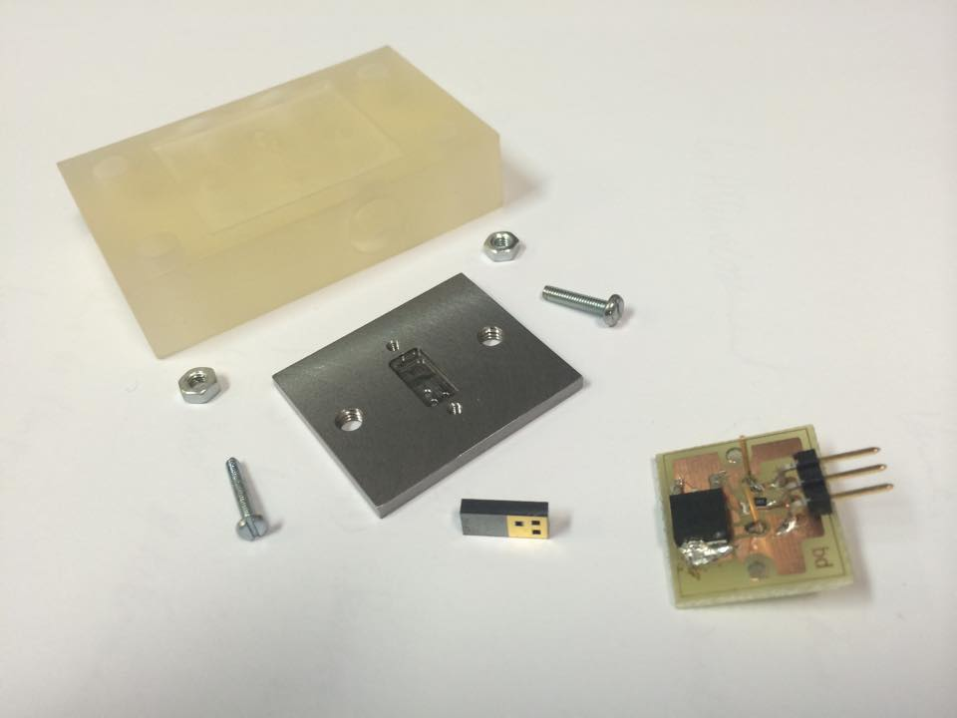
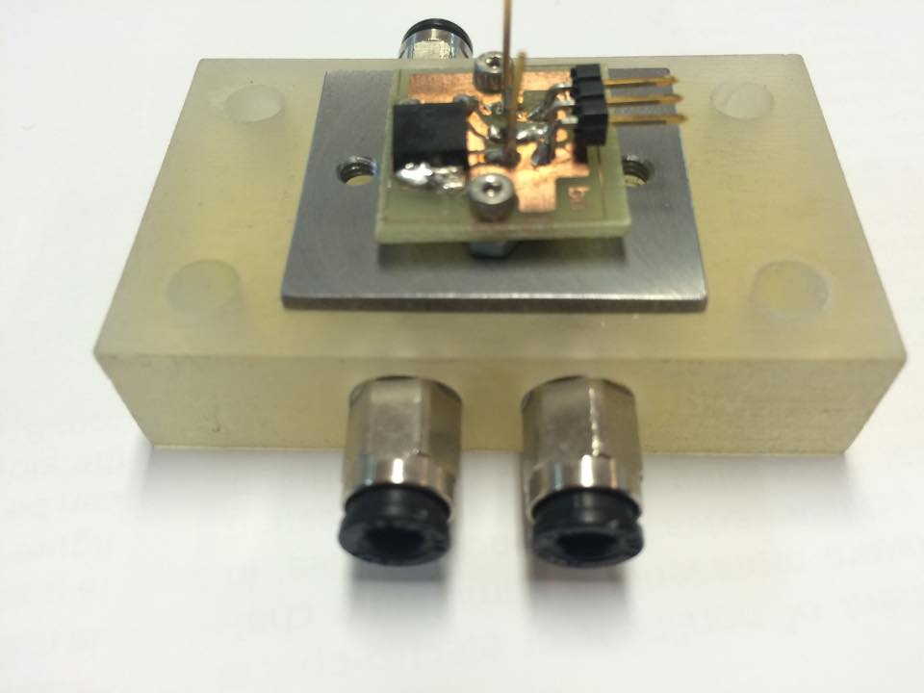


PHM of MEMS
Support used to fix the MEMS
Time response of the MEMS
Introduction State of the art PHM of MEMS Simulation results Conclusion

Slide 14
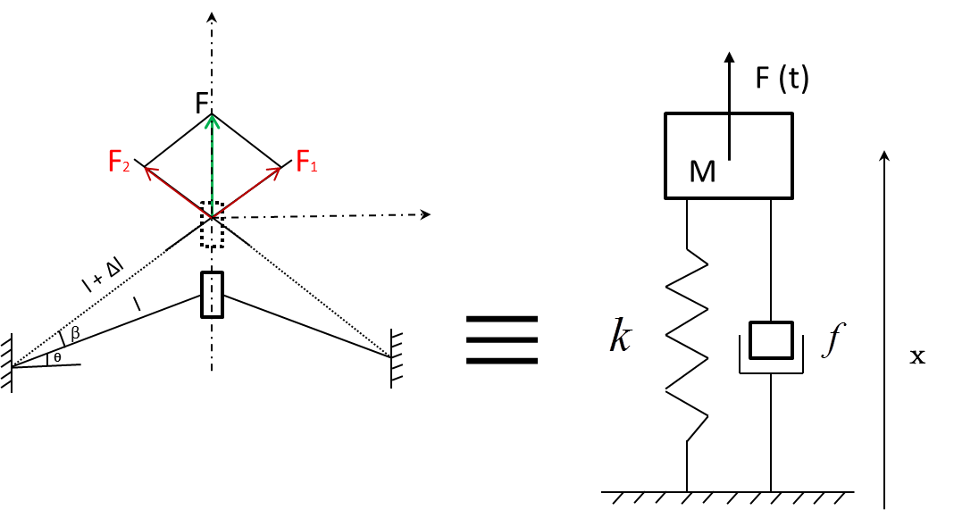
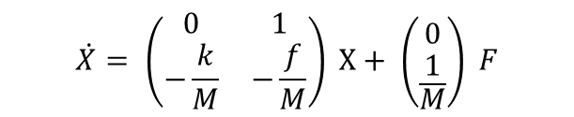
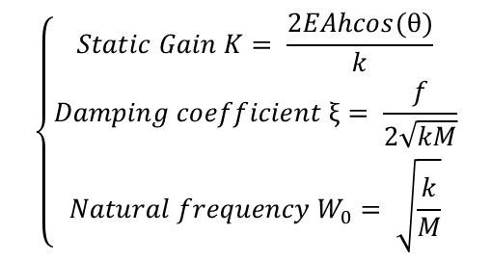
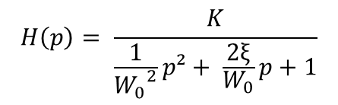
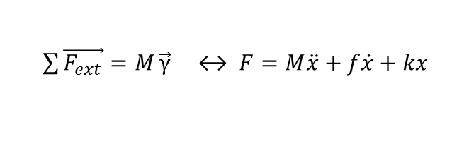
PHM of MEMS
Nominal behavior model
Deflection
Anchorage
ᶿ
Anchorage
$\sum{\vec{F_{ext}}=M}\vec{γ}$ ↔ $F=M\ddot{x}+f\dot{x}+kx$
Canonical transfer function:
$$H\left(p\right)= \frac{K}{\frac{1}{{W_{0}}^{2}}p²+ \frac{2ξ}{W_{0}}p+1}$$
$$\left\{\begin{aligned}Static Gain K= \frac{2EAhcos(θ)}{k} \\ Damping coefficient ξ= \frac{f}{2\sqrt{kM}} \\ Natural frequency W_{0}= \sqrt{\frac{k}{M}}\end{aligned}\right.$$
$$\dot{X}= \left(\begin{matrix}0 & 1 \\ −\frac{k}{M} & −\frac{f}{M}\end{matrix}\right) X+ \left({0 \atop \frac{1}{M}}\right) F$$
State representation:
Introduction State of the art PHM of MEMS Simulation results Conclusion

Slide 15



PHM of MEMS
Simulation of degradation
Why ?
  Manufacturer guarantees 10 million cycles without significant performance loss
  With a square wave (frequency= 1 Hz), the MEMS performs 86200 cycles per day
  → Approximately 3 months to observe significant drift of the performance
  To show the effectiveness of the proposed method
  Simulated degradation models
  The variation of the parameters depend on the variation of the stiffness k
  Degradation models of the MEMS valve represented by the variation of the stiffness k
Polynomial degradation:
$$k\left(t\right)=a ×t²+b ×t+1$$
Exponential degradation:
$$k\left(t\right)= e^{−at}$$
  Simulations are performed on Matlab
Introduction State of the art PHM of MEMS Simulation results Conclusion

Slide 16
Simulation results
Polynomial degradation
$$k\left(t\right)=a ×t²+b ×t+1$$
Introduction State of the art PHM of MEMS Simulation results Conclusion
Notes:
- The injection of these degradation models in the nominal behavior model leads to a global model. By analyzing the response time given by this model, the parameters of the system can be estimated at each time and then the health state can be obtained
We see here the impact of the degradation model on the response time. I have plotted three responses time for 3 different values of stiffness K

Slide 17

Simulation results
Exponential degradation
$$k\left(t\right)= e^{−at}$$
Introduction State of the art PHM of MEMS Simulation results Conclusion
Notes:
The same thing for the exponential degradation model, we see the impact on the response time of the system

Slide 18

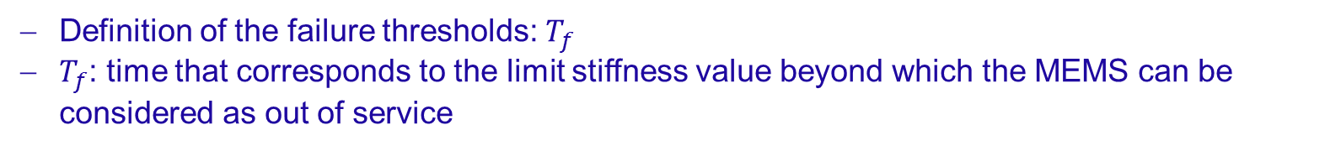
Simulation results
RUL estimation
Definition of the failure thresholds: $T_{f}$
$T_{f}$: time that corresponds to the limit stiffness value beyond which the MEMS can be considered as out of service
$$RUL\left(t\right)=T_{f} −t$$
Introduction State of the art PHM of MEMS Simulation results Conclusion

Slide 19
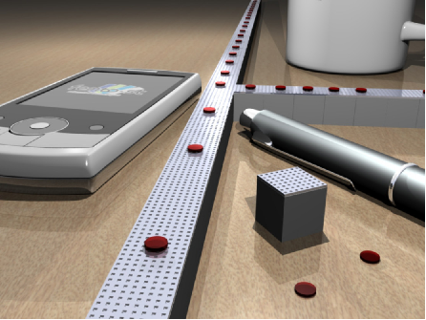
Conclusion
Implement PHM on MEMS
Hybrid Prognostic approach proposed
Experimental measurements performed
Nominal behavior of the MEMS valve derived
Simulation results showed the effectiveness of the proposed method
Ongoing and future works
Experiments are still ongoing to derive the degradation models which will allow to estimate the health state of the MEMS and predict their RUL
Optimize the performance and the availability of a distributed system containing numerous MEMS
Introduction State of the art PHM of MEMS Simulation results Conclusion

Slide 20

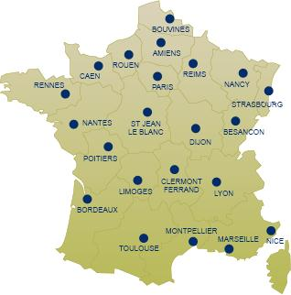





Thank you for your attention
H. Skima, K. Medjaher, C. Varnier, E. Dedu, J. Bourgeois, IEEE Aerospace Conference, March 7-14, 2015

